Slide 1
COMPUTER NETWORK AND DESIGN
CSCI 3385K Introduction to Routers

Slide 2
Introduction to Routers
A router is a computer, just like any other computer including a PC.
The very first router, used for the Advance Research Projects Agency Network (ARPANET) was the Interface Message Processor (IMP). The IMP was a Honeywell 316 minicomputer that brought the ARPANET to life on August 30, 1969.
Cisco routers are designed to address the needs of many different types of businesses and networks:
Branch: Teleworkers, small businesses, and medium size branch sites. Includes Cisco Integrated Services Routers (ISR) G2 (2nd Generation)
WAN: Large businesses, organizations, and enterprises. Includes the Cisco catalyst switches and the Cisco Aggregation Services Routers (ASR)
Service Provider: Large service providers. Includes Cisco ASR, Cisco CRS-3 Carrier Routing System, and 7600 Series routers.

Slide 3
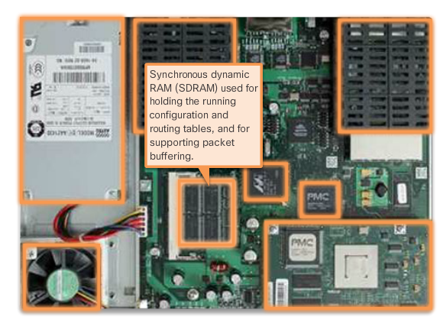
Routers CPU and OS
Routers have many of the same hardware and software components that are found in other computers including:
CPU
RAM
ROM
Operating System

Slide 4
Routers Memory
A router has access to volatile or non-volatile memory storage.
Volatile memory requires continual power to maintain its information. When router is power down or restarted, the content is erased and lost.
Non-volatile memory retains its information even when a device is rebooted.
Cisco router uses four types of memory:
RAM: volatile memory used in Cisco routers to store applications, processes, and data needed to be executed by the CPU. Cisco routers use a fast type of RAM called synchronous dynamic random access memory (SDRAM)
ROM: non-volatile memory used to store crucial operational instructions and a limited IOS. ROM firmware is embedded on an integrated circuit inside the router which can only be altered by Cisco.

Slide 5
Routers Memory – Cont.
NVRAM: This memory is used as the permanent storage for the startup configuration file (startup-config).
Flash: Flash memory is non-volatile computer memory used as permanent storage for the IOS and other system related files such as log files, voice configuration files, HTML files, backup configurations, and more. When a router

Slide 6
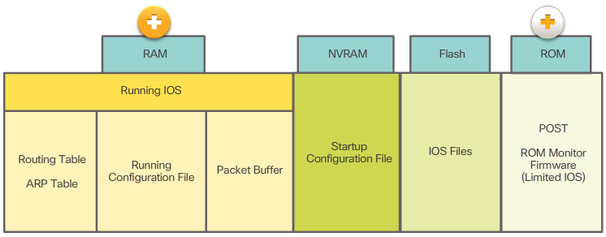
Routers Memory – Cont.

Slide 7
Connect to a Router
Cisco devices, routers, and switches typically interconnect many devices. For this reason, these devices have several types of ports and interfaces that are used to connect to the device.
For example a Cisco 1941 router backplane includes AUX port, compact flash slots, console ports, etc.
For example a Cisco 1841 router is a relative low cost ISR design for small to medium-sized businesses and small enterprise branch offices. It combines the features of data, security, and wireless services.
Light emitting diodes (LEDs) indicates the connection status of each port.

Slide 8
Connect to a Router
Double-wide eHWIC slots
eHWIC 0
AUX
port
LAN
interfaces
Console RJ45
USB
Ports
Two 4 GB flash card slots
Console
USB Type B

Slide 9
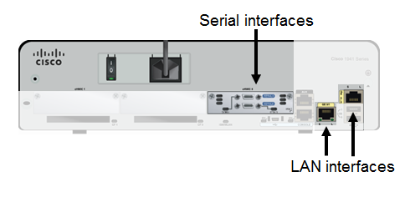
Connect to a Router – Cont.

Slide 10
Connect to a Router – Cont.

Slide 11
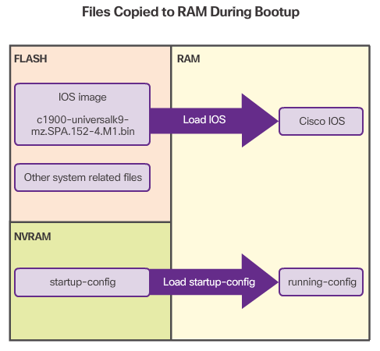
Bootset Files
Both Cisco routers and switches load the IOS image and startup configuration file into RAM when they are booted.
The running configuration is modified when a network administrator performs device configuration. Changes made to the running-config file should be saved to the startup configuration file in NVRAM, in case the router is restarted or loses power.

Slide 12
Router Bootup Process
There are three major phases to the bootup process:
Perform the POST and load the bootstrap program: During the power-on self-test, the router executes diagnostic from ROM on several hardware components, including the CPU, RAM, and NVRAM. After the POST, the bootstrap program is copied from ROM into RAM. The main task of the bootstrap program is to locate the Cisco IOS and load it into RAM.
Locate and load the Cisco ISO software: The IOS is typically stored in flash memory and is copied into RAM for execution by the CPU. If the IOS is not located in flash, then the router may look for it using Trivial File Transfer Protocol (TFTP) server. If a full IOS image cannot be located, a limited IOS is copied into RAM, which can be used to diagnose problems and transfer a full IOS into flash memory.
Locate and load the startup configuration file or enter setup mode: The bootstrap program then copies the startup configuration file from VNRAM into RAM. This becomes the running configuration. If the startup configuration file does not exist in NVRAM, the router may be configured to search for a TFTP server. If a TFTP server is not found, then the router displays the setup mode prompt. To terminate the setup mode process, press Ctrl+C in the CLI.

Slide 13
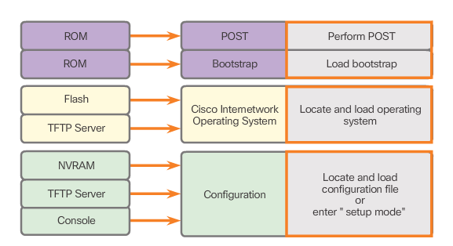
Router Bootup Process

Slide 14
Router – show version command
show version command: displays information about the version of the Cisco ISO software currently running on the router, the version of the bootstrap program and information about the hardware configuration including the amount of system memory.
The last line of the show version command displays the current configured value of the software configuration register in hexadecimal. If there is a second value is displayed in parentheses, it denotes the configuration register value that will be used during the next reload.
The configuration register has several uses, including password recovery. The factory default setting for the configuration register is 0x2102. This value indicates that the router will attempt to load a Cisco ISO software image from flash memory and load the startup configuration file from NVRAM. 0x2142 is for password recovery (bypass the startup-config file)

Slide 15
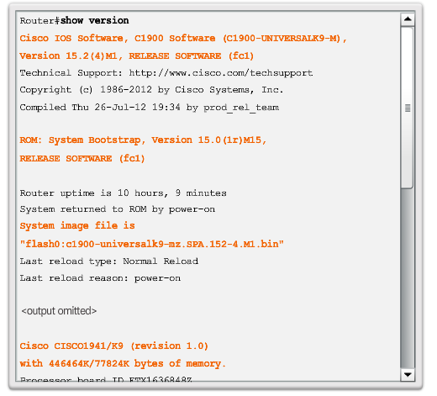
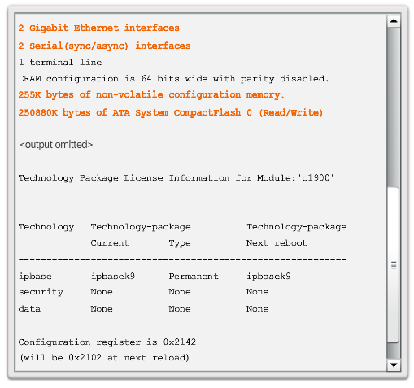
Router – show version command – Cont.

Slide 16
Router – LAN Interfaces
LAN interfaces are used to connect the router to the LAN, similar to how a PC Ethernet NIC is used to connect the PC to the Ethernet LAN.
Router Ethernet interface also has a Layer 2 MAC address and participates in the Ethernet LAN in the same way as any other host on that LAN (example: a router interface participates in the ARP process for that LAN, the router maintains an ARP cache for that interface, sends ARP requests when needed, and responds with ARP with ARP replies when required.)
A router interface usually uses a RJ-45 jack that support UTP cabling.
When a router is connected to a switch, a straight-through cable is used.
When two routers are connected directly through the Ethernet interface, or when a PC NIC is connected directly to a router interface, a crossover cable is used.

Slide 17
Router – WAN Interfaces
WAN interfaces are used to connect routers to external networks, usually over a larger geographical distance. The Layer 2 encapsulation, such as PPP, Frame Relay, and HDLC (High-Level Data Link Control).
Similar to LAN interfaces, each WAN interface has its own IP address and subnet mask, which identifies it as a member of a specific network. (Note: MAC Address is not used on WAN interfaces, they use their own Layer 2 addresses depending on the technology.)

Slide 18
Router Interfaces
The router in the next slide figure has four interfaces. Each interface has a Layer 3 IP address and subnet mask that configures it for a different network. The Ethernet interfaces also have Layer 2 Ethernet MAC addresses.
The WAN interfaces are using different Layer 2 encapsulations. Serial 0/0/0 is using HDLC and Serial 0/0/1 is using PPP. Both of these serial point-to-point protocols use a broadcast address for the Layer 2 destination address when encapsulating the IP packet into a data link frame.

Slide 19
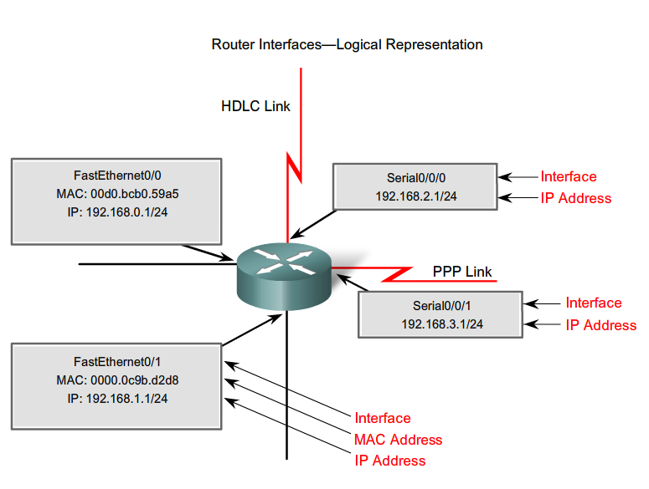
Router Interfaces – Cont.

Slide 20
Configure Router Interfaces
For routers to be reachable, the in-band router interfaces must be configured.
Configure the interface
interface type-and-number
description description-text
ip address ipv4-address subnet mask
no shutdown
Example:
R1(config)#interface FastEthernet0/0
R1(config-if)#ip address 192.168.1.1 255.255.255.0
R1(config-if)#no shutdown

Slide 21
Configure Router Interfaces – Cont.
Example 2:
R1(config)#interface gigabitethernet 0/0
R1(config-if)#ip address 192.168.1.1 255.255.255.0
R1(config-if)#no shutdown
Example 3:
R1(config)#interface Serial0/0
R1(config)#description Link to R2
R1(config-if)#ip address 192.168.1.1 255.255.255.0
R1(config-if)#no shutdown
R1(config-if)#clock rate 64000

Slide 22
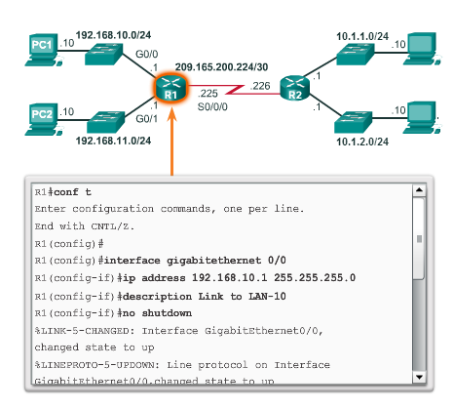
Configure Router Interfaces – Cont.

Slide 23
Router – Verify Interface Configuration
There are several command that can be used to verify interface configuration but the most common is the show ip interface brief command.
The output of the show ip interface brief command displays all interfaces, their IPv4 address, and their current status. The configured and connected interfaces should display a Status of “up” and Protocol “up”, anything else would indicate a problem with either the configuration or cabling.
You can use the ping command to verify connectivity.
Other interface verification command include:
show ip route: displays the content of the IPv4 routing table stored in RAM.
show interfaces: displays statistics for all interfaces on the device.
show ip interface: displays the IPv4 statistics for all interfaces on a router.

Slide 24
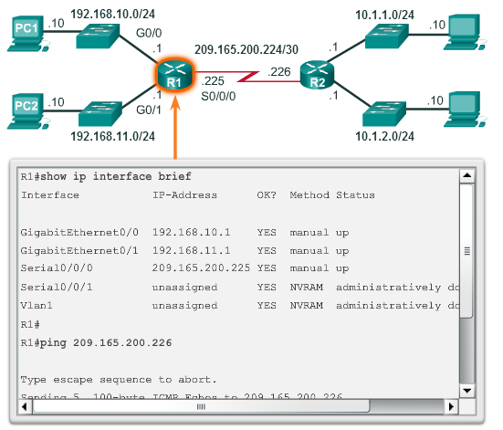
Router – Verify Interface Configuration

Slide 25
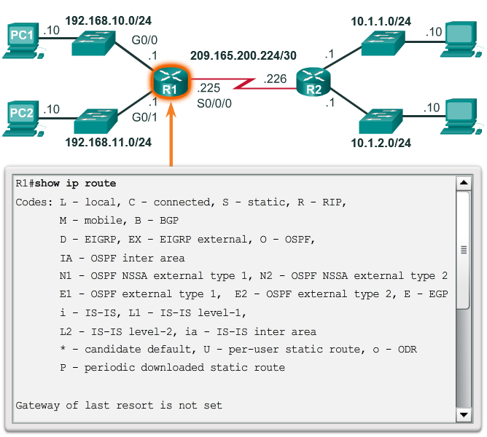
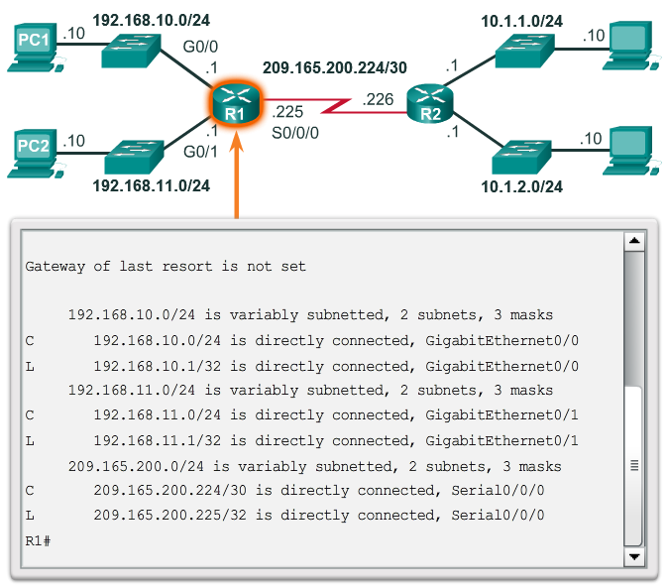
Router – Verify Interface Configuration

Slide 26
Default Gateway for a Host
For an end device to communicate over the network, it must be configured with the correct IP address information, including the default gateway address.
The default gateway is only used when a host wants to send a packet to a device on another network.
The default gateway address is generally the router interface address attached to the local network of the host. The IP address of the host device and the router interface address must be in the same network.

Slide 27
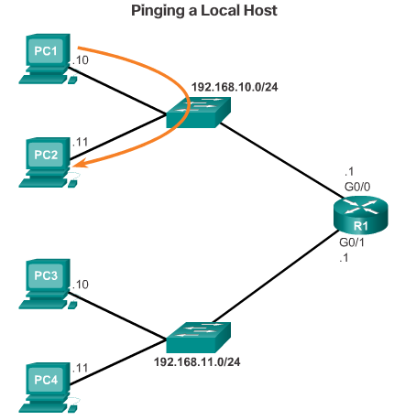
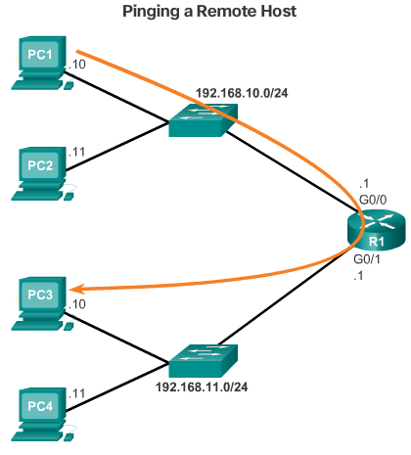
Default Gateway for a Host – Cont.

Slide 28
Default Gateway for a Switch
A Layer 2 switch does not require an IP address to function properly. However, if you wish to connect to the switch and administratively manage it over multiple networks, you will need to configure the SVI (Switch Virtual Interface) with an IP address, subnet mask and default gateway.
The default gateway is typically configured on all devices that wish to communicate beyond just their local network.
To configure a default gateway on a switch use the ip default-gateway global configuration command. The IP address configured is that of the router interface of the connected switched.

Slide 29
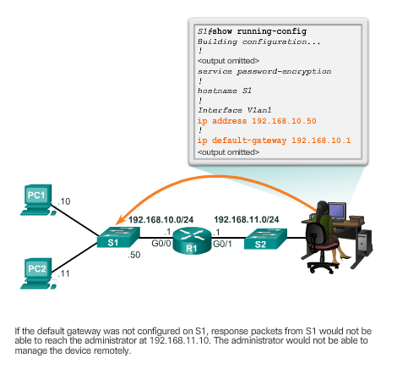
Default Gateway for a Switch

Slide 30
Introduction to Routing Table
The primary function of a router is to forward a packet toward its destination network, which is the destination IP address of the packet. To do this, a router needs to search the routing information stored in its routing table.
A routing table is a data file in RAM that is used to stored route information about directly connected and remote networks. The routing table contains network/next hop associations. These associations tell the router that a particular destination can be optimally reached by sending the packet to a specific router that represent the “next hop” on the way to the final destination. The next hop association can also be the outgoing or exit interface to the final destination.
The network/exit interface association can also represent the destination network address of the IP packet. This association occurs on the router’s directly connected networks.

Slide 31
Introduction to Routing Table – Cont.
Directly-connected routes: These routes come from the active router interface. Routers add a directly connected route when an interface is configured with an IP address and is activated. Each of the router’s interfaces is connected to a different network segments.
Remote routes: These routes come from remote networks connected to other routers. Routes to these networks can be manually configured on the local router by the network administrator or dynamically configured by enabling the local router to exchange routing information with other routers using a dynamic routing protocol.
Default route: Like a host, routers also use a default route as a last resort if there is no other route to the desire network in the routing table.

Slide 32
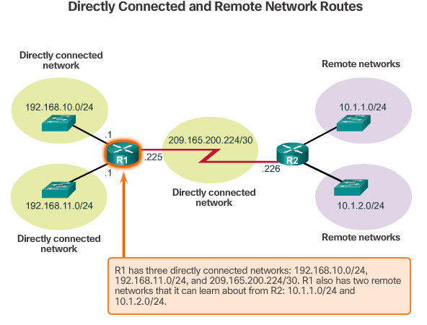
Introduction to Routing Table – Cont.

Slide 33
IPv4 Router Routing Table
On a Cisco IOS router, the show ip route command can be used to display the router’s routing table.
In addition to providing routing information for directly-connected networks and remote networks, the routing table also has information on how the route was learned, the trustworthiness and rating of the route, when the route was last updated, and which interface to use to reach the requested destination.
When a packet arrives at the router interface, the router examines the packet header to determine the destination network. If the destination network matches a route in the routing table, the router forwards the packet using the information specified in the routing table. If there are two or more possible routes to the same destination, the metric is used to decide which route appears in the routing table.

Slide 34
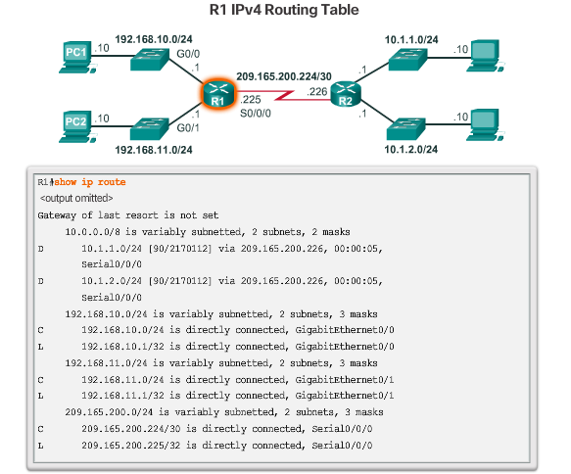
IPv4 Router Routing Table

Slide 35
Directly Connected Routing Table Entries
When a router interface is configured with an IPv4 address, a subnet mask, and is activated, the following two routing table entries are automatically created:
C – Identifies a directly-connected network. Directly-connected networks are automatically created when an interface is configured with an IP address and activated.
L – Identifies that this is a local interface. This is the IPv4 address of the interface on the router.
The next slide figure describes the routing table entries on R1 for the directly-connected network 192.168.10.0. These entries were automatically added to the routing table when the GigabitEthernet 0/0 interface was configured and activated

Slide 36
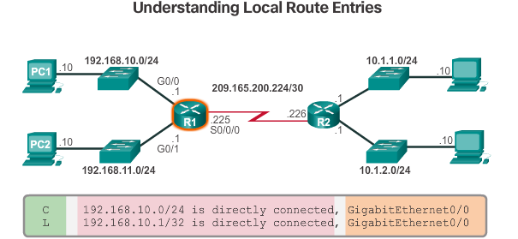
Directly Connected Routing Table Entries
Route source – Identifies how the network was learned by the router.
Destination network – Identifies the destination network and how it was learned.
Outgoing interface – Identifies the exit interface to use to forward a packet toward the final destination.

Slide 37
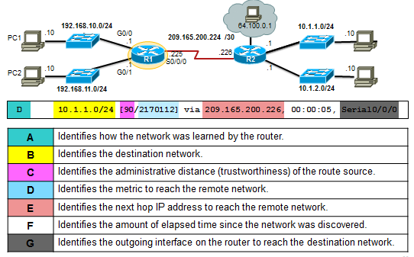
Remote Network Routing Table Entries

Slide 38
Next-Hop Address
When a packet destined for a remote network arrives at the router, the router matches the destination network to a route in the routing table. If match is found, the router forwards the packet to the next hop address out of the identified interface.
Example: Assume that either PC1 or PC2 has sent a packet destined for either the 10.1.1.0 or 10.1.2.0 network. When the packet arrives on the R1 Gigabit interface, R1 will compare the packet’s destination IPv4 address to entries in its routing table. Based on the content of its routing, R1 will forward the packet out of its serial 0/0/0 interface to the next hop address 209.165.200.226. Notice how connected networks with a route source of C and L have no next-hop address, this is because a router can forward packets directly to host on these networks using the designated interface.
It is important to understand that packets cannot be forwarded by the router without a route for the destination network in the routing table. If a route representing the destination network is not in the routing table, the packet is dropped. However, just as a host can use a default gateway to forward a packet to an unknown destination, a router can also be configured to use a default static route to create a Gateway of Last Resort.

Slide 39
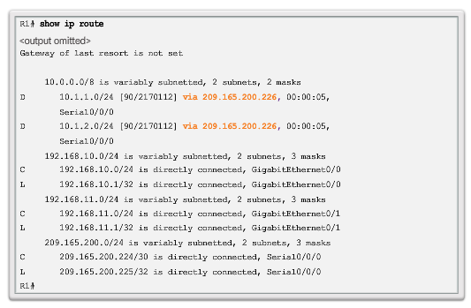
Next-Hop Address – Cont.

