Slide 1
COMPUTER NETWORK AND DESIGN
CSCI 3385K Subnetting IP networks

Slide 2
Network Segmentation – Broadcast Domain
In a Ethernet LAN, devices use broadcast to locate:
Other devices: A device uses ARP (Address Resolution Protocol) which sends Layer 2 broadcast to a known IPv4 address on the local network to discover the associated MAC address.
Services: A host typically acquires its IP address configuration using DHCP (Dynamic Host Configuration Protocol) which sends broadcasts on the local network to locate DCHP server.
Switches propagate broadcasts out all interfaces except the interface on which it was received.
Example: If a switch were to receive a broadcast, it would forward it to the other switches and other users connected in the network.
Routers do not propagate broadcast, when a router receives a broadcast, it does not forward it out other interfaces.
Therefore, each router interface connects a broadcast domain and broadcasts are only propagated within its specific broadcast domain.

Slide 3
Broadcast Domain – Cont.

Slide 4
Problems with Large Broadcast Domain
A large broadcast domain is a network that connects many host. A problem with a large broadcast domain is that these hosts can generate excessive broadcasts and negatively affect the network.
A network that connects 400 users could generate broadcast traffic resulting in:
Slow network operation due to the significant amount of traffic it can cause
Slow device operations because a device must accept and process each broadcast packet.

Slide 5
Problems with Large Broadcast Domain – Cont.

Slide 6
Problems with Large Broadcast Domain – Cont.
The solution of this problem is to reduced the size of the network to create smaller broadcast domains in a process called subnetting.
These smaller network spaces are called subnets.
Note: The terms subnet and network are often used interchangeably. Most networks are subnet of some larger address block.

Slide 7
Problems with Large Broadcast Domain – Cont.
The 400 users in LAN 1 with address 172.16.0.0/16 have been divided into two subnets of 200 users each; 172.16.0.0/24 and 172.16.1.0/24. Broadcast are only propagated within the smaller broadcast domains. Therefore LAN 1 would not propagate to LAN 2.
Notice prefix changed from /16 to /24, this is the basis of subnetting; using hosts bits to create additional subnets.

Slide 8
Reasons for Subnetting
Subnetting reduces overall network traffic and improve network performance.
Enables an administrator to implement security policies such as which subnets are allowed and not allowed to communicate together.
There are various ways of using subnets to help manage network devices.
Network administrators can group devices and services into subnets that determined by:
Location
Organizational Unit
Device type
Any other division that make sense for network.

Slide 9
Reasons for Subnetting – Cont.
Network administrators can group devices and services into subnets that are determined by: Location

Slide 10
Reasons for Subnetting – Cont.
Network administrators can group devices and services into subnets that are determined by:
Organizational Unit

Slide 11
Reasons for Subnetting – Cont.
Network administrators can group devices and services into subnets that are determined by:
Device Type

Slide 12
Subnetting Networks on the Octet Boundary
IPv4 subnets are created by using one or more of the host bits as network bits. This is done by extending the subnet mask to borrow some of the bits from the host portion of the address to create additional network bits. The more bits that are borrowed, the more subnets that can be defined.
Network are most easily subnetted at the octet boundary of /8, /16, and /24.
The prefix length is equivalent to the subnet masks, the network and host bits, and the number of hosts each subnet can connect.
Using longer prefix lengths decreases the number of hosts per subnet.

Slide 13
Subnetting Networks on the Octet Boundary

Slide 14
Subnetting on the Octet Boundary
To understand how subnetting on the octet boundary can be useful, consider the following example. Assume an enterprise has chosen the private address 10.0.0.0/8 as its internal network address. That network can connect 16,777,214 hosts in broadcast domain. Obviously, that is not ideal. The enterprise could further subnet the 10.0.0.0/8 address at the octet boundary of /16. This would provide the enterprise the ability to define up to 256 subnets (10.0.0.0/16 to 10.255.0.0/16) with each subnet capable of connecting 65,534 hosts. Notice that the first two octets identify the network portion and the other two octets identify the host portion (host IP addresses). Alternatively, the enterprise could choose to subnet at the /24 octet boundary. This would enable the enterprise to define 65,536 subnets each capable of connecting 254 hosts. The /24 boundary is very popular in subnetting because it accommodates a reasonable number of hosts and conveniently subnets at the octet boundary.

Slide 15
Subnetting on the Octet Boundary – Cont.

Slide 16
Subnetting on the Octet Boundary – Cont.

Slide 17
Classless Subnetting
Subnets can borrow bits from any host bit portion to create other masks.
For instance:
/25 borrowing 1 bit from the fourth octet creates 2 subnets supporting 126 host each,
/26 borrowing 2 bits created 4 subnets supporting 62 hosts each.
/27 borrowing 3 bits created 8 subnets supporting 30 hosts each.
/28 borrowing 4 bits created 16 subnets supporting 14 hosts each.
/29 borrowing 5 bits created 32 subnets supporting 6 hosts each.
/30 borrowing 6 bits created 64 subnets supporting 2 hosts each.

Slide 18
Classless Subnetting – Cont.

Slide 19
Classless Subnetting Example

Slide 20
Classless Subnetting Example

Slide 21
Creating 2 Subnets
Router interfaces must be assigned within the valid host range for the assigned subnet. This is the address that hosts on that network will use as their default gateway. A very common practice is to use the first or last available address in a network range. Use the ip address interface configuration command to configure the interface.

Slide 22
Creating 2 Subnets – Cont. (LAN 1)

Slide 23
Creating 2 Subnets – Cont. (LAN 2)

Slide 24
Creating 2 Subnets – Cont. (LAN 2)

Slide 25
Creating 2 Subnets – Cont. (LAN 2)

Slide 26
Subnetting Formulas
To calculate number of subnets
2^n (n=bits borrowed)

Slide 27
Subnetting Formulas – Cont.
To calculate number of hosts
2^n-2 (n=number of bits remaining in the host field)

Slide 28
Creating 4 subnets

Slide 29
Creating 4 subnets – Cont.

Slide 30
Creating 4 subnets – Cont.

Slide 31
Creating 4 subnets – Cont.

Slide 32
Creating 4 subnets – Cont.

Slide 33
Creating Subnets with a /16 prefix
In a situation requiring a larger number of subnets, an IP network is required that has more hosts bits to borrow from. For example, the network address 172.16.0.0 has a default mask of 255.255.0.0, or /16. This address has 16 bits in the network portion and 16 bits in the host portion. The 16 bits in the host portion are available to borrow for creating subnets. The table in the figure highlights all the possible scenarios for subnetting a /16 prefix.
Although a complete memorization of the table is not required, it is suggested that you gain a good understanding of how each value in the table is generated. Do not let the size of the table intimidate you. The reason it is big is because it has 8 additional bits that can be borrowed, and, therefore, the number of subnets and hosts are simply larger.

Slide 34
Creating Subnets with a /16 prefix

Slide 35
Creating 100 Subnets with /16 Network
Consider a large enterprise that requires at least 100 subnets and has chosen the private address 172.16.0.0/16 as its internal network address.
When borrowing bits from a /16 address, start borrowing bits in the third octet, going from left to right. Borrow a single bit at a time until the number of bits necessary to create 100 subnets is reached.
The number of subnets that can be created when borrowing bits from the third octet and the fourth octet. Notice there is now up to 14 host bits that can be borrowed.
To satisfy the requirements of the enterprise, 7 bits (i.e., 2^7 = 128 subnets) would need to be borrowed
Recall that the subnet mask must change to reflect the borrowed bits. In this example, when 7 bits are borrowed, the mask is extended 7 bits into the third octet. In decimal, the mask is represented as 255.255.254.0, or a /23 prefix, because the third octet is 11111110 in binary and the fourth octet is 00000000 in binary.
The resulting subnets from 172.16.0.0 /23 up to 172.16.254.0 /23.

Slide 36
Creating 100 Subnets with /16 Network

Slide 37
Creating 100 Subnets with /16 Network

Slide 38
Calculating the Hosts

Slide 39
Creating 1000 Subnets with a /8 Network
Some organizations, such as small service providers or large enterprises, may need even more subnets. Take, for example, a small ISP that requires 1000 subnets for its clients. Each client will need plenty of space in the host portion to create their own subnets.
The network address 10.0.0.0 has a default subnet mask of 255.0.0.0 or /8. This means there are 8 bits in the network portion and 24 host bits available to borrow toward subnetting. Therefore, the small ISP will subnet the 10.0.0.0/8 network.
As always, in order to create subnets we must borrow bits from the host portion of the IP address of the existing internetwork. Starting from the left to the right with the first available host bit, we will borrow a single bit at a time until we reach the number of bits necessary to create 1000 subnets.
We need to borrow 10 bits to create 1024 subnets. Specifically, we need to borrow the 8 bits in the second octet and 2 additional bits from the third octet.
The network address and the resulting subnet mask which converts to 255.255.192.0 or a /18 prefix.
The resulting subnets of borrowing 10 bits creating subnets from 10.0.0.0 /18 to 10.255.255.128.0 /18.
14 host bits were not borrowed, therefore, 2^14 - 2 = 16382. This indicates that each of the 1000 subnets can support up to 16,382 hosts.

Slide 40
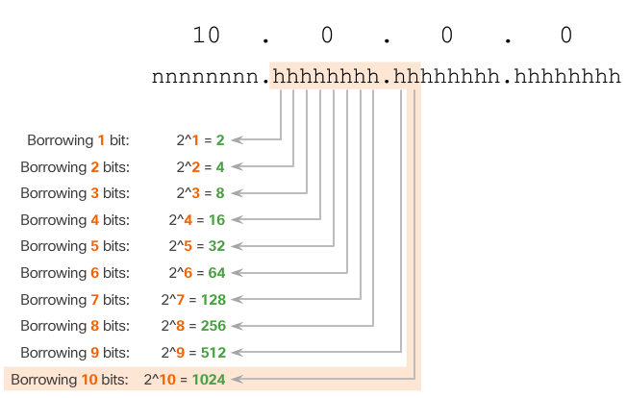
Creating 1000 Subnets with a /8 Network – Cont.

Slide 41
Creating 1000 Subnets with a /8 Network – Cont.

Slide 42
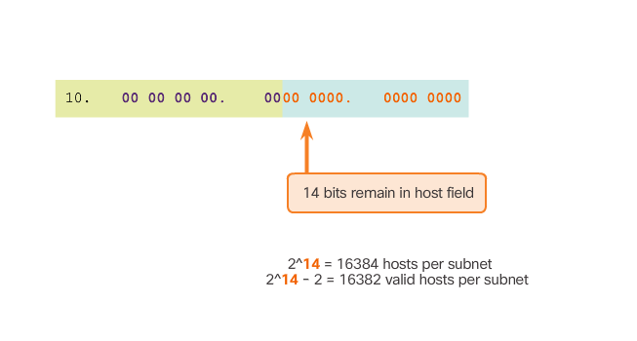
Creating 1000 Subnets with a /8 Network – Cont.
Calculate Number of Hosts

Slide 43
Subnetting Based on Host Requirements
There are two considerations when planning subnets:
the number of host addresses required for each network
the number of individual subnets needed
The table in the next slide displays the specifics for subnetting a /24 network. Notice how there is an inverse relationship between the number of subnets and the number of hosts. The more bits borrowed to create subnets, the fewer host bits available. If more host addresses are needed, more host bits are required, resulting in fewer subnets.
The number of host addresses required in the largest subnet will determine how many bits must be left in the host portion. Recall that two of the addresses cannot be used, so the usable number of addresses can be calculated as 2^n-2.

Slide 44
Subnetting Based on Host Requirements – Cont.

Slide 45
Subnetting Based on Network Requirements
Sometimes a certain number of subnets is required, with less emphasis on the number of host addresses per subnet. This may be the case if an organization chooses to separate their network traffic based on internal structure or department setup. For example, an organization may choose to put all host devices used by employees in the Engineering department in one network, and all host devices used by management in a separate network. In this case, the number of subnets is most important in determining how many bits to borrow.
Recall the number of subnets created when bits are borrowed can be calculated using the formula 2^n (where n is the number of bits borrowed). The key is to balance the number of subnets needed and the number of hosts required for the largest subnet. The more bits borrowed to create additional subnets means fewer hosts available per subnet.

Slide 46
Subnetting Based on Network Requirements – Cont.

Slide 47
Network Requirement Example
Network administrators must devise the network addressing scheme to accommodate the maximum number of hosts for each network and the number of subnets. The addressing scheme should allow for growth in the both the number of host addresses per subnet and the total number of subnets.
In this example, corporate headquarters has allocated a private network address of 172.16.0.0/22 (10 host bits) to a branch location. This will provide 1,022 host addresses.
The topology for the branch locations consists of 5 LAN segments and 4 internetwork connections between routers. Therefore, 9 subnets are required. The largest subnet requires 40 hosts.
The 172.16.0.0/22 network address has 10 host bits. Because the largest subnet requires 40 hosts, a minimum of 6 host bits are needed to provide addressing for 40 hosts. This is determined by using this formula: 2^6 – 2 = 62 hosts.
Using the formula for determining subnets, results in 16 subnets: 2^4 = 16. Because the example internetwork requires 9 subnets this will meet the requirement and allow for some additional growth.
Therefore, the first 4 host bits can be used to allocate subnets. When 4 bits are borrowed, the new prefix length is /26 with a subnet mask of 255.255.255.192.
The subnets can be assigned to the LAN segments and router-to-router connections.

Slide 48
Network Requirement Example – Cont.

Slide 49
Network Requirement Example – Cont.

Slide 50
Network Requirement Example – Cont.

Slide 51
Traditional Subnetting Wastes Addresses
Using traditional subnetting, the same number of addresses is allocated for each subnet. If all the subnets have the same requirements for the number of hosts, these fixed size address blocks would be efficient. However, most often that is not the case.
For example, the topology shown in Figure 1 requires seven subnets, one for each of the four LANs, and one for each of the three WAN connections between routers. Using traditional subnetting with the given address of 192.168.20.0/24, 3 bits can be borrowed from the host portion in the last octet to meet the subnet requirement of seven subnets. As shown in Figure 2, borrowing 3 bits creates 8 subnets and leaves 5 host bits with 30 usable hosts per subnet. This scheme creates the needed subnets and meets the host requirement of the largest LAN.
Although this traditional subnetting meets the needs of the largest LAN and divides the address space into an adequate number of subnets, it results in significant waste of unused addresses.
For example, only two addresses are needed in each subnet for the three WAN links. Because each subnet has 30 usable addresses, there are 28 unused addresses in each of these subnets. As shown in Figure 3, this results in 84 unused addresses (28x3).
Further, this limits future growth by reducing the total number of subnets available. This inefficient use of addresses is characteristic of traditional subnetting. Applying a traditional subnetting scheme to this scenario is not very efficient and is wasteful.
Subnetting a subnet, or using Variable Length Subnet Mask (VLSM), was designed to avoid wasting addresses.

Slide 52
Traditional Subnetting Wastes Addresses
Figure 1

Slide 53
Traditional Subnetting Wastes Addresses
Figure 2

Slide 54
Traditional Subnetting Wastes Addresses
Figure 3

Slide 55
Variable Length Subnet Masks
In all of the previous examples of subnetting, notice that the same subnet mask was applied for all the subnets. This means that each subnet has the same number of available host addresses.
As illustrated in Figure 1, traditional subnetting creates subnets of equal size. Each subnet in a traditional scheme uses the same subnet mask. As shown in Figure 2, VLSM allows a network space to be divided into unequal parts. With VLSM, the subnet mask will vary depending on how many bits have been borrowed for a particular subnet, thus the “variable” part of the VLSM.
VLSM subnetting is similar to traditional subnetting in that bits are borrowed to create subnets. The formulas to calculate the number of hosts per subnet and the number of subnets created still apply.
The difference is that subnetting is not a single pass activity. With VLSM, the network is first subnetted, and then the subnets are subnetted again. This process can be repeated multiple times to create subnets of various sizes.

Slide 56
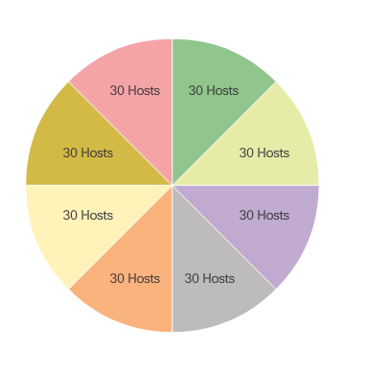
Variable Length Subnet Masks – Cont.
Figure 1

Slide 57
Variable Length Subnet Masks – Cont.
Figure 2

Slide 58
Basic VLSM
To better understand the VLSM process, go back to the previous example, shown in Figure 1. The network 192.168.20.0/24 was subnetted into eight equal-sized subnets. Seven of the eight subnets were allocated. Four subnets were used for the LANs and three subnets for the WAN connections between the routers. Recall that the wasted address space was in the subnets used for the WAN connections, because those subnets required only two usable addresses: one for each router interface. To avoid this waste, VLSM can be used to create smaller subnets for the WAN connections.
To create smaller subnets for the WAN links, one of the subnets will be divided. In this example, the last subnet, 192.168.20.224/27, will be further subnetted.
Recall that when the number of needed host addresses is known, the formula 2^n-2 (where n equals the number of host bits remaining) can be used. To provide two usable addresses, 2 host bits must be left in the host portion.
Because there are 5 host bits in the subnetted 192.168.20.224/27 address space, 3 more bits can be borrowed, leaving 2 bits in the host portion, as shown in Figure 2. The calculations at this point are exactly the same as those used for traditional subnetting. The bits are borrowed, and the subnet ranges are determined.
This VLSM subnetting scheme reduces the number of addresses per subnet to a size appropriate for the WANs. Subnetting subnet 7 for WANs, allows subnets 4, 5, and 6 to be available for future networks, as well as 5 additional subnets available for WANs.

Slide 59
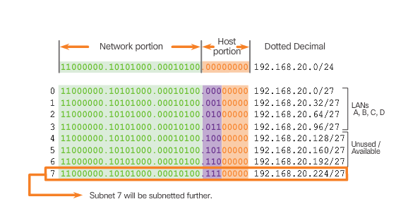
Basic VLSM – Cont.
Figure 1

Slide 60
Basic VLSM – Cont.
Figure 2

Slide 61
VLSM in Practice
Using the VLSM subnets, the LAN and WAN segments can be addressed without unnecessary waste.
As shown in Figure 1, the hosts in each of the LANs will be assigned a valid host address with the range for that subnet and /27 mask. Each of the four routers will have a LAN interface with a /27 subnet and a one or more serial interfaces with a /30 subnet.
Using a common addressing scheme, the first host IPv4 address for each subnet is assigned to the LAN interface of the router. The WAN interfaces of the routers are assigned the IP addresses and mask for the /30 subnets.
Figures 2 - 5 show the interface configuration for each of the routers.
Hosts on each subnet will have a host IPv4 address from the range of host addresses for that subnet and an appropriate mask. Hosts will use the address of the attached router LAN interface as the default gateway address.
Default gateway for Building A hosts (192.168.20.0/27) will be 192.168.20.1.
Default gateway for Building B hosts (192.168.20.32/27) will be 192.168.20.33.
Default gateway for Building C hosts (192.168.20.64/27) will be 192.168.20.65.
Default gateway for Building D hosts (192.168.20.96/27) will be 192.168.20.97.

Slide 62
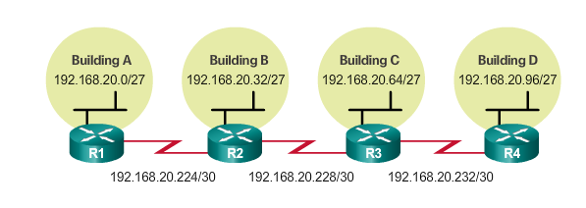
VLSM in Practice – Cont.
Figure 1

Slide 63
VLSM in Practice – Cont.
Figure 2

Slide 64
VLSM in Practice – Cont.
Figure 3

Slide 65
VLSM in Practice – Cont.
Figure 4

Slide 66
VLSM in Practice – Cont.
Figure 5

Slide 67
VLSM Chart
An addressing chart can be used to identify which blocks of addresses are available for use and which ones are already assigned, as shown in Figure 1. This method helps to prevent assigning addresses that have already been allocated.
In order to use the address space more efficiently, /30 subnets are created for WAN links, as shown in the VLSM chart in Figure 2. To keep the unused blocks of addresses together in a block of contiguous address space, the last /27 subnet was further subnetted to create the /30 subnets. The first 3 subnets were assigned to WAN links.
Designing the addressing scheme in this way leaves 3 unused, contiguous /27 subnets and 5 unused contiguous /30 subnets.

Slide 68
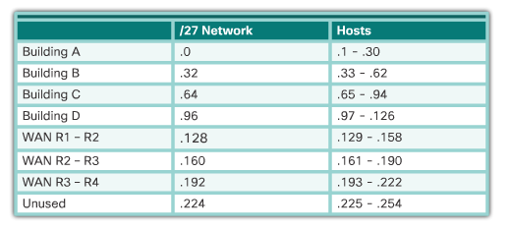
VLSM Chart – Cont.
Figure 1

Slide 69
VLSM Chart – Cont.
Figure 2

Slide 70
Network Addressing Planning

Slide 71
Network Addressing Planning
The allocation of network layer address space within the corporate network needs to be well designed. Address assignment should not be random.
Planning network subnets requires examination of both the needs of an organization’s network usage and how the subnets will be structured.
Performing a network requirement study is the starting point. This means looking at the entire network and determining the main sections of the network and how they will be segmented.
The address plan includes determining the needs of each subnet in terms of size, how many hosts per subnet, how hosts addresses will be assigned, which hosts will require static IP addresses and which host can use DHCP for obtaining their addressing information.

Slide 72
Network Addressing Planning – Cont.
The size of the subnet involves planning the number of hosts that will require IP addresses in each subnet of the subdivided private network. For example, in a campus network design, you might consider how many hosts are needed in the Administrative LAN, how many in the Faculty LAN, and how many in the Student LAN. In a home network, a consideration might be done by the number of hosts in the Main House LAN and the number of hosts in the Home Office LAN.
As discussed earlier, the private IP address range used on a LAN is the choice of the network administrator and needs careful consideration to be sure that enough host addresses will be available for the currently known hosts and for future expansion. Remember the private IP address ranges are:
10.0.0.0 - 10.255.255.255 with a subnet mask of 255.0.0.0 or /8
172.16.0.0 – 172.31.255.255 with a subnet mask of 255.240.0.0 or /12
192.168.0.0 – 192.168.255.255 with a subnet mask of 255.255.0.0 or /16
Knowing your IP address requirements will determine the range or ranges of host addresses you implement. Subnetting the selected private IP address space will provide the host addresses to cover your network needs.
Public addresses used to connect to the Internet are typically allocated from a service provider. So, while the same principles for subnetting would apply, this is not generally the responsibility of the organization’s network administrator.

Slide 73
Planning to Address the Network
Three primary considerations are:
Preventing the duplication of addresses: refers to the fact that each host in an internetwork must have a unique address. Without the proper planning and documentation, an address could be assigned to more than one host, resulting in access issues for both hosts.
Providing and controlling access: refers to the fact that some hosts, such as servers, provide resources to internal hosts as well as to external hosts. The Layer 3 address assigned to a server can be used to control access to that server. If, however, the address is randomly assigned and not well documented, controlling access is more difficult.
Monitoring security and performance of hosts: means network traffic is examined for source IP addresses that are generating or receiving excessive packets. If there is proper planning and documentation of the network addressing, problematic network devices should easily be found.

Slide 74
Planning to Address the Network

Slide 75
Assigning Addresses to Devices
Within a network, there are three different types of devices that require addresses including:
End user clients: Most networks allocate addresses dynamically using Dynamic Host Configuration Protocol (DHCP). This reduces the burden on network support staff and virtually eliminates entry errors. As well, addresses are only leased for a period of time. Changing the subnetting scheme means that the DHCP server needs to be reconfigured, and the clients must renew their IP addresses.
Servers and peripherals: These should have a predictable static IP address. Use a consistent numbering system for these devices.
Servers that are accessible from the Internet: In many networks, servers must be made available to the remote users. In most cases, these servers are assigned private addresses internally, and the router or firewall at the perimeter of the network must be configured to translate the internal address into a public address.

Slide 76
Assigning Addresses to Devices – Cont.
Intermediary devices: These devices are assigned addresses for network management, monitoring, and security. Because we must know how to communicate with intermediary devices, they should have predictable, statically assigned addresses.
Gateway: Routers and firewall devices have an IP address assigned to each interface which serves as the gateway for the hosts in that network. Typically, the router interface uses either the lowest or highest address in the network.
When developing an IP addressing scheme, it is generally recommended to have a set pattern of how addresses are allocated to each type of device. This benefits administrators when adding and removing devices, filtering traffic based on IP, as well as simplifying documentation.

Slide 77
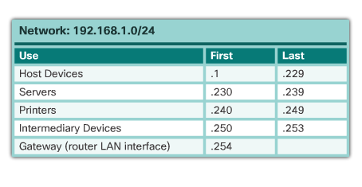
Assigning Addresses to Devices – Cont.

Slide 78
The IPv6 Global Unicast Address
IPv6 subnetting requires a different approach than IPv4 subnetting. The primary reason is that with IPv6 there are so many addresses, that the reason for subnetting is completely different. Refer to the figure for a quick review of the structure of an IPv6 global unicast address.
IPv4 subnetting is not only about limiting broadcast domains but is also about managing address scarcity. Determining the subnet mask and the use of VLSM is done to help conserve IPv4 addresses. IPv6 subnetting is not concerned with conserving address space. The subnet ID includes more than enough subnets. IPv6 subnetting is about building an addressing hierarchy based on the number of subnetworks needed.
Recall that there are two types of assignable IPv6 addresses. An IPv6 link-local address is never subnetted because it exists only on the local link. However, an IPv6 global unicast address can be subnetted.
The IPv6 global unicast address normally consists of a /48 global routing prefix, a 16 bit subnet ID, and a 64 bit interface ID.

Slide 79
The IPv6 Global Unicast Address

Slide 80
Subnetting Using the Subnet ID
The 16 bit subnet ID section of the IPv6 global unicast address can be used by an organization to create internal subnets.
The subnet ID provides more than enough subnets and host support than will ever be needed in one subnet. For instance, the 16 bit section can:
Create up to 65,536 /64 subnets. This does not include the possibility of borrowing any bits from the interface ID of the address.
Support up to 18 quintillion host IPv6 addresses per subnet (i.e., 18,000,000,000,000,000,000).
Note: Subnetting into the 64 bit Interface ID (or host portion) is also possible but it is rarely required.
IPv6 subnetting is also easier to implement than IPv4, because there is no conversion to binary required. To determine the next available subnet, just count up in hexadecimal.
For example, assume an organization has been assigned the 2001:0DB8:ACAD::/48 global routing prefix with a 16 bit subnet ID. This would allow the organization to create /64 subnets, as shown in the figure. Notice how the global routing prefix is the same for all subnets. Only the subnet ID hextet is incremented in hexadecimal for each subnet.

Slide 81
Subnetting Using the Subnet ID – Cont.

Slide 82
IPv6 Subnet Allocation
As shown in Figure 1, the example topology will require subnets for each LAN as well as for the WAN link between R1 and R2. Unlike the example for IPv4, with IPv6 the WAN link subnet will not be subnetted further. Although this may “waste” addresses, that is not a concern when using IPv6.
As shown in Figure 2, the allocation of five IPv6 subnets, with the subnet ID field 0001 through 0005 will be used for this example. Each /64 subnet will provide more addresses than will ever be needed.
As shown in Figure 3, each LAN segment and the WAN link is assigned a /64 subnet.
Similar to configuring IPv4, Figure 4 shows that each of the router interfaces has been configured to be on a different IPv6 subnet.
Refer the Chapter Appendix for more information subnetting IPv6 into the interface ID.

Slide 83
IPv6 Subnet Allocation – Cont.
Figure 1

Slide 84
IPv6 Subnet Allocation – Cont.
Figure 2

Slide 85
IPv6 Subnet Allocation – Cont.
Figure 3

Slide 86
IPv6 Subnet Allocation – Cont.
Figure 4

