Slide 1
EVO
Hardware Components
Introduction
OZOBOT
Motor, Battery, and others
Ozobot: EVO
Hardware Components
Two Ways to Code
Motherboard
Hardware Components
Color codes, and Ozobot Blockly
Sensors,
LED lights

Slide 2
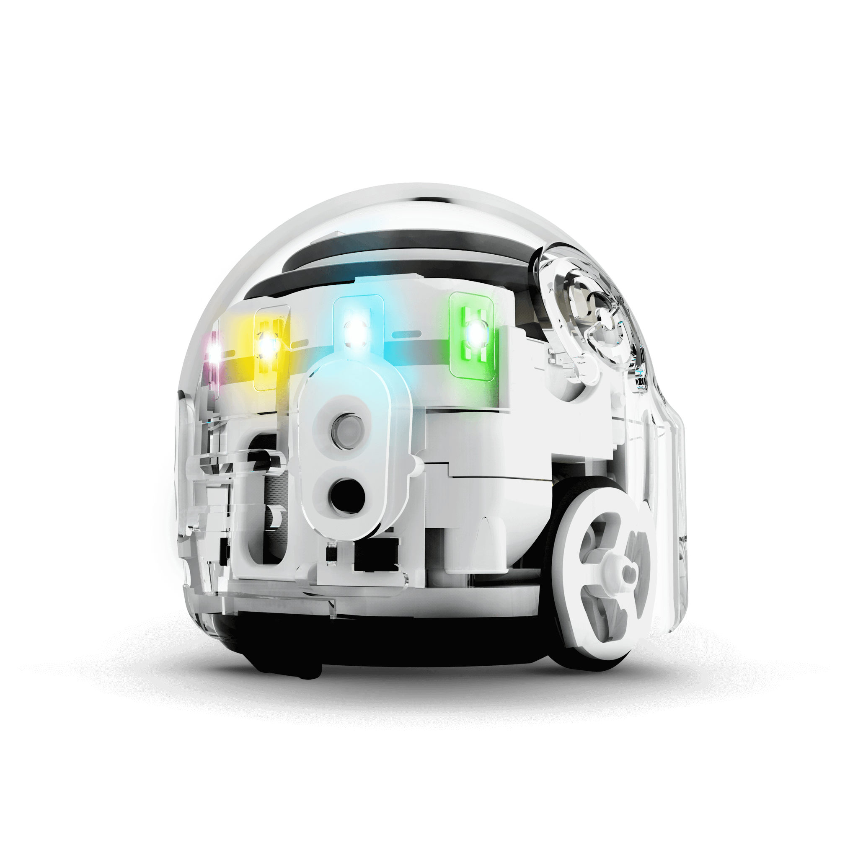
What is a Ozobot
Ozobot (EVO) is a miniature robot, the smallest of its kind, and there are a lot of things Ozobot can do:
Ozobot drives on lines
Ozobot can sense colors
Ozobot can receive commands
This Photo by Unknown Author is licensed under CC BY-SA-NC

Slide 3
Two Ways to Code
Evo can be programmed in two ways:
Color Codes, and Ozobot Blockly.
Evo can follow commands to execute movements, speed, sounds, lights, and more!

Slide 4
Hardware Components:
This Photo by Unknown Author is licensed under CC BY-SA-NC

Slide 5
Code # 1 Calibration and Speed
This Photo by Unknown Author is licensed under CC BY-SA-NC

Slide 6
code#2 Speed
This Photo by Unknown Author is licensed under CC BY-SA-NC

Slide 7
Code# 3 Special move and win
This Photo by Unknown Author is licensed under CC BY-SA-NC

Slide 8
Code# 4 Direction
This Photo by Unknown Author is licensed under CC BY-SA-NC

Slide 9
Code#5 Special skill
This Photo by Unknown Author is licensed under CC BY-SA-NC

Slide 10
Codes# 7: Line Switch
This Photo by Unknown Author is licensed under CC BY-SA-NC

Slide 11
Code# 8 Counters
This Photo by Unknown Author is licensed under CC BY-SA-NC

